Slide 1


1
INTRODUCTION TO WEB DEVELOPMENT
Code: COMP07009
Week 3
Reference: http://www.w3schools.com/html

Slide 2
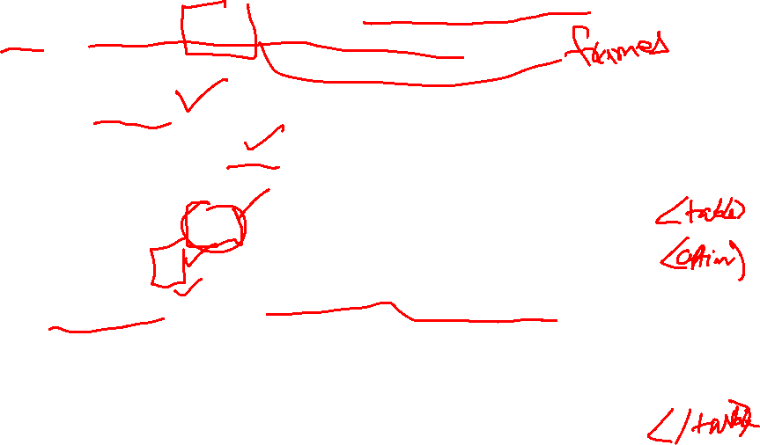
Tables
2
Should only be used to display tabular information and NOT for defining layout of the web page
Defined using:
Table tag <table> which encloses the whole table
Table caption tag <caption> must be inserted immediately after the <table> tag and one can be used per table
Table header tag <th> specifies header info
Table row tag <tr> encloses the whole row
Table data tag <td> encloses each cell within the row

Slide 3
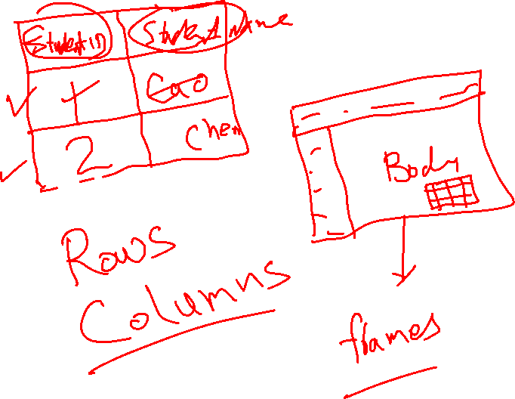

Slide 4
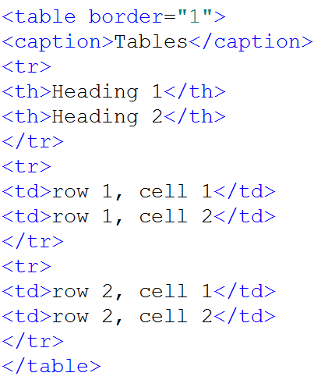

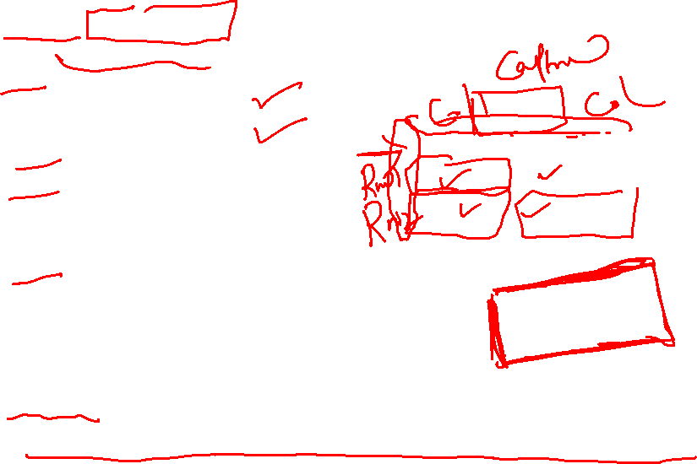
Example
3
The border attribute is required to show the borders of the table

Slide 5
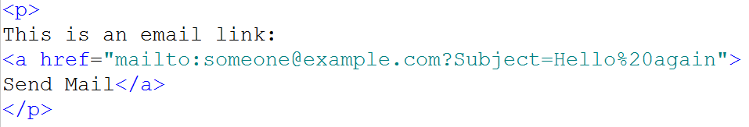
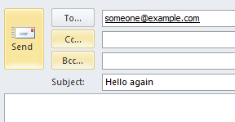
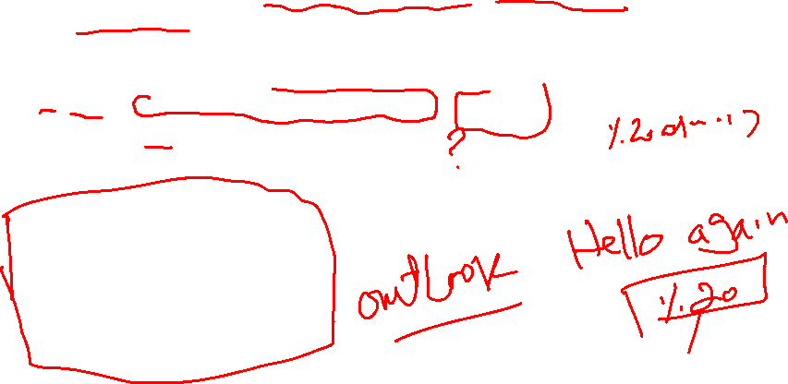
Email Link
4
Defined within the anchor <a> tag inside the value of the href attribute
Automatically open the email program
Note: Spaces between words should be replaced by %20 to ensure that the browser will display the text properly.

Slide 6
Forms
5
Allows user to select different types of input
Can be processed client side or server side
Contains different elements eg <form> ….. </form>
Supports Global attributes which can be used on any HTML element
id specifies a unique id for an element
Supports Event attributes which let events trigger actions in a browser
onload
onclick
fires after the page is finished loading
execute Javascript when a user clicks on an element

Slide 7
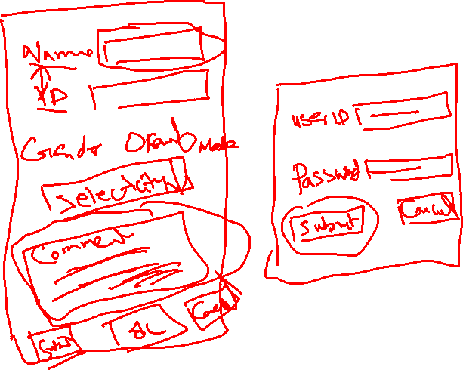

Slide 8
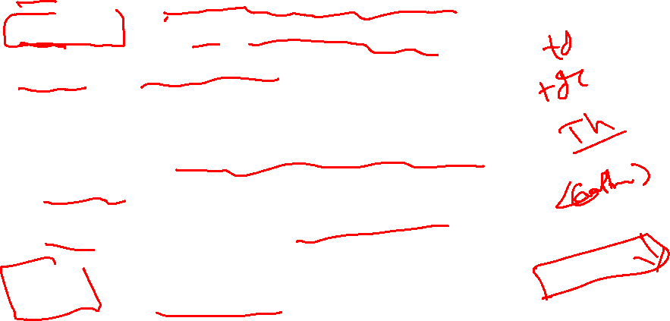
Form tags
6
form
textarea
input
label
fieldset
legend
Select
option
button
HTML form for user input
multi-line text input control
input control
label for an input element
groups related items on a form
caption for a fieldset element
select list (drop down list)
option in a select list
push button

Slide 9
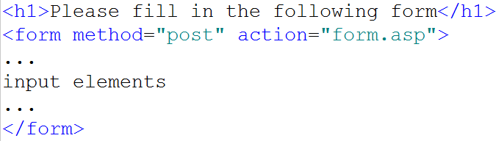
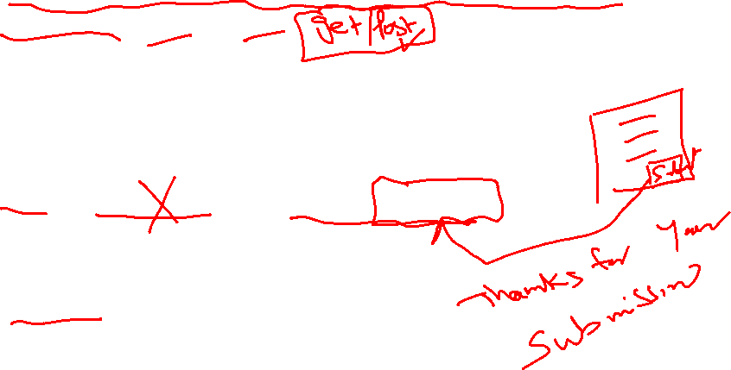
Example
7
Method attribute tells the browser how the form data will be submitted (get or post)
Action attribute specifies where to send the form data when it is submitted

Slide 10
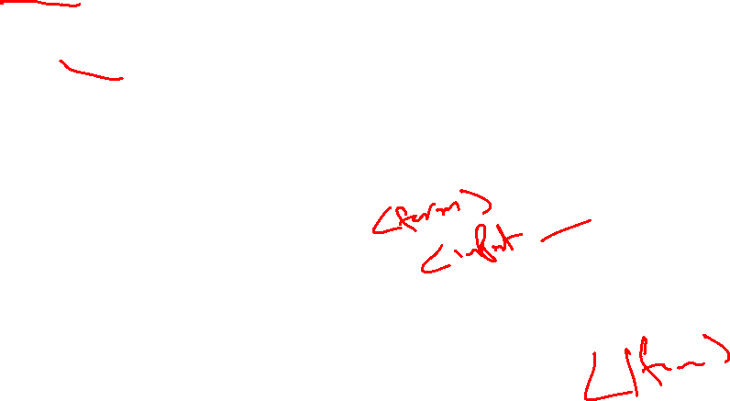
Input
8
Specifies an input field where the user can enter data
<input> elements are used within a <form> element to set input controls
The <label> element defines labels for <input> elements
Many new attributes in HTML5 although varied support across browsers
An input field can vary in many ways, depending on the type attribute

Slide 11
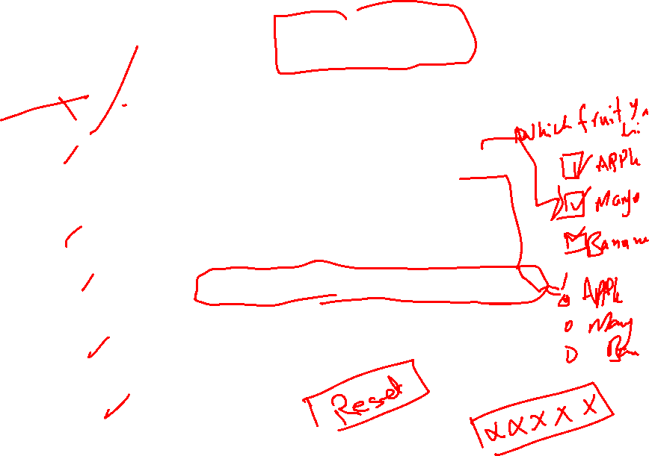
Type attribute for <input> tag
9
Text
Checkbox
Radio button
Password
Button
File
Submit
Reset
And more …
single line text field (default)
can choose more than 1
can only choose one
characters are masked
push button
browse button to locate file
submits data
resets all form values

Slide 12
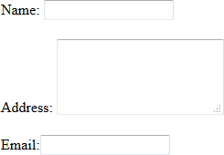
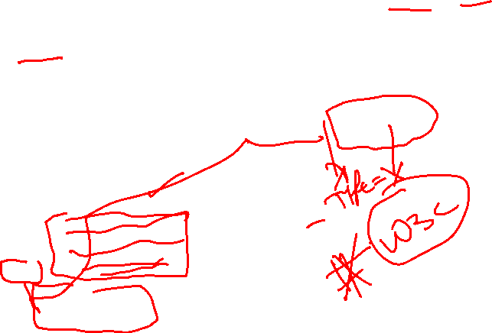
Text / Email
10
Name:
<input type="text" name="name" id="name" /> <br /><br />
Address:
<textarea name="message" id="address" rows="4" cols="20"></textarea><br /><br />
Email:<input type="email" name="email" id="email" />

Slide 13


Checkbox
11
Multiple options many be chosen
<h1>Courses of interest</h1>
Computing
<input type="checkbox" name="computing" id="computing" /> Computer Networking
<input type="checkbox" name="compnet" id="compnet" /> Information Technology
<input type="checkbox" name="it" id="it" />

Slide 14

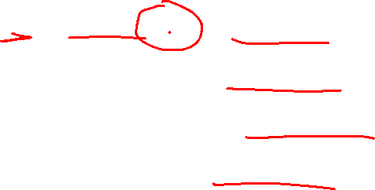
Radio button
12
User can only select one of a limited number of choices
Name must be same for each option
<h2>Year</h2>
One<input type="radio" name="year" id="one" />
Two<input type="radio" name="year" id="two" />
Three<input type="radio" name="year" id="three" />
Four <input type="radio" name="year" id="four" />

Slide 15

Password
13
Characters are masked
Password<input type="password" name="password" id="password">

Slide 16
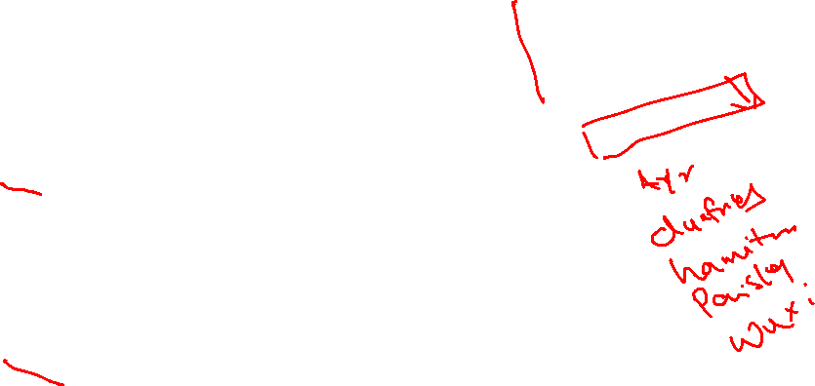
Select list (choose one)
14
Creates a list of options named “campus”
First option selected
In this example, it will be blank
Only one value can be chosen
<h2>Campus</h2> Which location?
<select name="campus" id="campus“>
<option value=""></option>
<option value="ayr">Ayr</option>
<option value="dumfries">Dumfries</option>
<option value="hamiton">Hamilton</option>
<option value="paisley">Paisley</option>
</select>

Slide 17

Select list (choose >1)
15
Use the multiple attribute
Allows more than one selection
Make first selection, press CTRL key and make further selections
<h2>Campus</h2> Which location? <select name="campus" id="campus" multiple="multiple"> <option value="ayr">Ayr</option> <option value="dumfries">Dumfries</option> <option value="hamiton">Hamilton</option>
<option value="paisley">Paisley</option> </select>

Slide 18

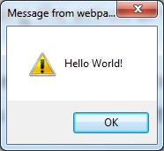
Buttons
16
type=“submit” (Submits form data using the action of the opening form tag)
type=“reset” (Clears the form data entered or selected)
type=“button” makes it a clickable button
onclick executes Javascript code inside double quotes
<input type="submit" name="send" value="Submit"/>
<input type="reset" name="reset" value="Clear Form"/>
<input type="button" name="button" value="Click me" onclick="alert('Hello World!’)"/>

Slide 19
New input types
17
HTML5 has many new types for better control and validation such as:
color
datetime
Email
range
search
url
week
However, support varies across browsers

Slide 20

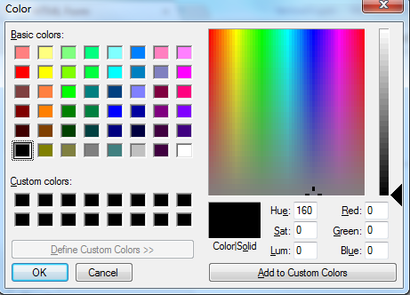
Example
18
Note the American spelling
Color type is used for user to select a colour (note the spelling)
Select default colour to display colour pick
er

Slide 21
Multimedia
19
Movies / Animations / Sound
Different multimedia formats
File extension indicates format
Until now, most multimedia files played through plug-ins (like flash)
However, different browsers may use different plug-ins
User may need to install various plug-ins to view
multimedia content across browsers
HTML5 now defines new native elements which provide a standard way to embed multimedia on a web page
Converters can be used to change formats
Good practice to store media files in separate folder

Slide 22
Video
20
<video>, <source> and <track> tags
Control attribute adds video controls like play and pause
Autoplay attribute will play the video automatically
Text content should be inserted between the <video> and
</video> tags for browsers that do not support the element
Useful to include width and height attributes
Allows multiple sources to be used
Browser will use the first recognised format
Currently, there are 3 major formats
MP4
WebM
Ogg
Different level of support across browsers

Slide 23

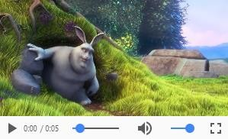
Example
21
http://www.sample-videos.com

Slide 24

Example – YouTube
22
Use the youtube site to find the video you want
Click the ‘Share’ button below the video
Click the ‘Embed’ button next to the link they show you
Copy the iframe code given and paste it into the html of your web page

Slide 25
Audio
23
<audio> and <source> tags
Also has a control attribute
Text content should be inserted between the <audio> and
</audio> tags for browsers that do not support the
element
Allows multiple sources to be used
Browser will use the first recognised format
Currently, there are 3 major formats
MP3
Wav
Ogg
Different level of support across browsers

Slide 26


Audio
24

Slide 27
Lab
33
Available on Moodle for this week
It is very important that you are able to upload files and folders onto your individual account on the media server so try this out in the lab!!
If you have any problems then staff will help you in lab
Don’t wait until the assessments need to be uploaded as it is too late to resolve any issues
There is a separate section on Moodle called FTP Instructions with different examples of setting up an FTP connection

